Slide 1
Distributed Computing for Data Mining

Slide 2
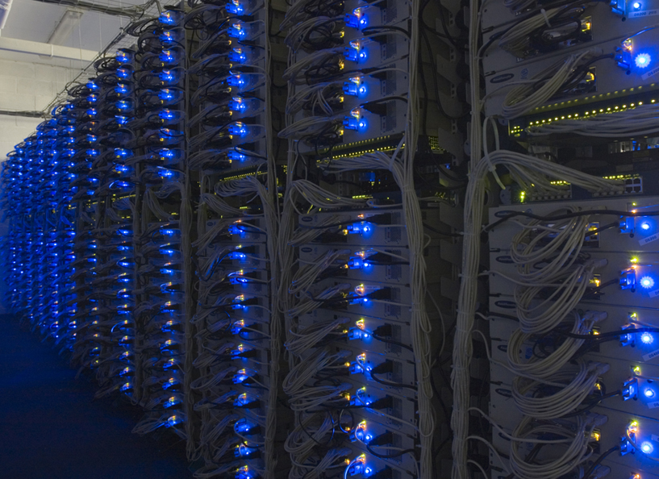

Slide 3
Large-scale Computing
Large-scale computing for data mining problems on commodity hardware
Challenges:
How do you distribute computation?
How can we make it easy to write distributed programs?
Machines fail:
One server may stay up 3 years (1,000 days)
If you have 1,000 servers, expect to loose 1/day
With 1M machines 1,000 machines fail every day!

Slide 4
An Idea and a Solution
Issue: Copying data over a network takes time
Idea:
Bring computation to data
Store files multiple times for reliability
Spark/Hadoop address these problems
Storage Infrastructure – File system
Google: GFS. Hadoop: HDFS
Programming model
MapReduce
Spark

Slide 5
Storage Infrastructure
Problem:
If nodes fail, how to store data persistently?
Answer:
Distributed File System
Provides global file namespace
Typical usage pattern:
Huge files (100s of GB to TB)
Data is rarely updated in place
Reads and appends are common

Slide 6
Distributed File System
Chunk servers
File is split into contiguous chunks
Typically each chunk is 16-64MB
Each chunk replicated (usually 2x or 3x)
Try to keep replicas in different racks
Master node
a.k.a. Name Node in Hadoop’s HDFS
Stores metadata about where files are stored
Might be replicated
Client library for file access
Talks to master to find chunk servers
Connects directly to chunk servers to access data

Slide 7
Distributed File System
Reliable distributed file system
Data kept in “chunks” spread across machines
Each chunk replicated on different machines
Seamless recovery from disk or machine failure
C₀
C₁
D₀
C₁
C₂
C₅
C₀
C₅
…
C₅
Chunk server 1
C₂
C₅
Chunk server 2
C₃
D₀
Chunk server 3
D₁
D₀
Chunk server N
C₂
Bring computation directly to the data!
Chunk servers also serve as compute servers
Notes:
7

Slide 8
Programming Model
MapReduce is a style of programming designed for:
Easy parallel programming
Invisible management of hardware and software failures
Easy management of very-large-scale data
It has several implementations, including Hadoop, Spark (used in this class), Flink, and the original Google implementation just called “MapReduce”

Slide 9
MapReduce: Overview
3 steps of MapReduce
Map:
Apply a user-written Map function to each input element
Mapper applies the Map function to a single element
Many mappers grouped in a Map task (the unit of parallelism)
The output of the Map function is a set of 0, 1, or more key-value pairs.
Group by key: Sort and shuffle
System sorts all the key-value pairs by key, and outputs key-(list of values) pairs
Reduce:
User-written Reduce function is applied to each key-(list of values)
Outline stays the same, Map and Reduce change to fit the problem

Slide 10
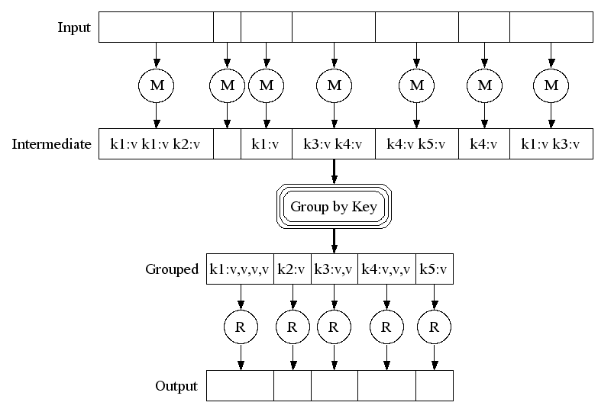
Map-Reduce: A diagram
MAP:
Read input and produces a set of key-value pairs
Group by key:
Collect all pairs with same key
(Hash merge, Shuffle, Sort, Partition)
Reduce:
Collect all values belonging to the key and output

Slide 11
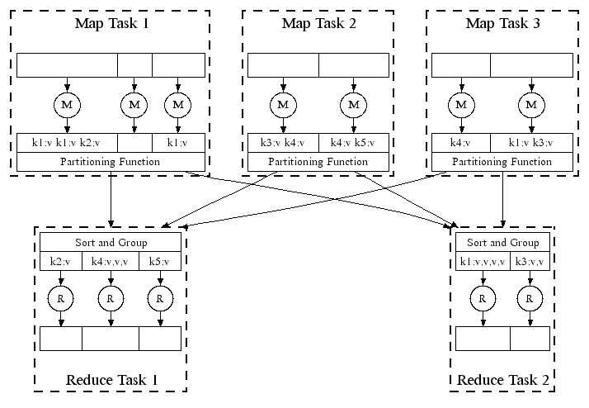
Map-Reduce: In Parallel
All phases are distributed with many tasks doing the work

Slide 12
MapReduce Pattern
key-value
pairs
Input
Output
Mappers
Reducers

Slide 13
Example: Word Counting
Example MapReduce task:
We have a huge text document
Count the number of times each distinct word appears in the file
Many applications of this:
Analyze web server logs to find popular URLs
Statistical machine translation:
Need to count number of times every 5-word sequence occurs in a large corpus of documents

Slide 14
MapReduce: Word Counting
Provided by the programmer
Provided by the programmer
MAP:
Read input and produces a set of key-value pairs
Group by key:
Collect all pairs with same key
Reduce:
Collect all values belonging to the key and output
The crew of the space shuttle Endeavor recently returned to Earth as ambassadors, harbingers of a new era of space exploration. Scientists at NASA are saying that the recent assembly of the Dextre bot is the first step in a long-term space-based man/mache partnership. '"The work we're doing now -- the robotics we're doing -- is what we're going to need ……………………..
(The, 1)
(crew, 1)
(of, 1)
(the, 1)
(space, 1)
(shuttle, 1)
(Endeavor, 1)
(recently, 1)
….
(crew, 1)
(crew, 1)
(space, 1)
(the, 1)
(the, 1)
(the, 1)
(shuttle, 1)
(recently, 1)
…
(crew, 2)
(space, 1)
(the, 3)
(shuttle, 1)
(recently, 1)
…
Sequentially read the data
Only sequential reads
Big document
(key, value)
(key, value)
(key, value)

Slide 15
Word Count Using MapReduce
map(key, value):
// key: document name; value: text of the document
for each word w in value:
emit(w, 1)
reduce(key, values):
// key: a word; value: an iterator over counts
result = 0
for each count v in values:
result += v
emit(key, result)

Slide 16
MapReduce: Environment
MapReduce environment takes care of:
Partitioning the input data
Scheduling the program’s execution across a set of machines
Performing the group by key step
In practice this is is the bottleneck
Handling machine failures
Managing required inter-machine communication

Slide 17
Dealing with Failures
Map worker failure
Map tasks completed or in-progress at worker are reset to idle and rescheduled
Reduce workers are notified when map task is rescheduled on another worker
Reduce worker failure
Only in-progress tasks are reset to idle and the reduce task is restarted

Slide 18
Spark

Slide 19
Problems with MapReduce
Two major limitations of MapReduce:
Difficultly of programming directly in MR
Many problems aren’t easily described as map-reduce
Performance bottlenecks, or batch not fitting the use cases
Persistence to disk typically slower than in-memory work
In short, MR doesn’t compose well for large applications
Many times one needs to chain multiple map-reduce steps

Slide 20
Data-Flow Systems
MapReduce uses two “ranks” of tasks: One for Map the second for Reduce
Data flows from the first rank to the second
Data-Flow Systems generalize this in two ways:
Allow any number of tasks/ranks
Allow functions other than Map and Reduce
As long as data flow is in one direction only, we can have the blocking property and allow recovery of tasks rather than whole jobs

Slide 21
Spark: Most Popular Data-Flow System
Expressive computing system, not limited to the map-reduce model
Additions to MapReduce model:
Fast data sharing
Avoids saving intermediate results to disk
Caches data for repetitive queries (e.g. for machine learning)
General execution graphs (DAGs)
Richer functions than just map and reduce
Compatible with Hadoop

Slide 22
Spark: RDD
Key concept Resilient Distributed Dataset (RDD)
Partitioned collection of records
Generalizes (key-value) pairs
Spread across the cluster, Read-only
Caching dataset in memory
Different storage levels available
Fallback to disk possible
RDDs can be created from Hadoop, or by transforming other RDDs (you can stack RDDs)
RDDs are best suited for applications that apply the same operation to all elements of a dataset

Slide 23
Spark RDD Operations
Transformations build RDDs through deterministic operations on other RDDs:
Transformations include map, filter, join, union, intersection, distinct
Lazy evaluation: Nothing computed until an action requires it
Actions to return value or export data
Actions include count, collect, reduce, save
Actions can be applied to RDDs; actions force calculations and return values

Slide 24
Task Scheduler: General DAGs
A:
B:
F:
Stage 1
groupBy
C:
D:
E:
join
= RDD
Stage 2
map
filter
Stage 3
= cached partition
Supports general task graphs
Pipelines functions where possible
Cache-aware data reuse & locality
Partitioning-aware to avoid shuffles
Notes:
NOT a modified version of Hadoop

Slide 25
Data Analytics Software Stack

Slide 26
Problems Suited for MapReduce

Slide 27
Example: Host size
Suppose we have a large web corpus
Look at the metadata file
Lines of the form: (URL, size, date, …)
For each host, find the total number of bytes
That is, the sum of the page sizes for all URLs from that particular host
Other examples:
Link analysis and graph processing
Machine Learning algorithms

Slide 28
Example: Language Model
Statistical machine translation:
Need to count number of times every 5-word sequence occurs in a large corpus of documents
Very easy with MapReduce:
Map:
Extract (5-word sequence, count) from document
Reduce:
Combine the counts

Slide 29
Example: Join By Map-Reduce
Compute the natural join R(A,B) ⋈ S(B,C)
R and S are each stored in files
Tuples are pairs (a,b) or (b,c)
A | B
a₁ | b₁
a₂ | b₁
a₃ | b₂
a₄ | b₃
B | C
b₂ | c₁
b₂ | c₂
b₃ | c₃
A | C
a₃ | c₁
a₃ | c₂
a₄ | c₃
⋈
=
S
R

Slide 30
Map-Reduce Join
Use a hash function h from B-values to 1...k
A Map process turns:
Each input tuple R(a,b) into key-value pair (b,(a,R))
Each input tuple S(b,c) into (b,(c,S))
Map processes send each key-value pair with key b to Reduce process h(b)
Hadoop does this automatically; just tell it what k is.
Each Reduce process matches all the pairs (b,(a,R)) with all (b,(c,S)) and outputs (a,b,c).

Slide 31
Problems NOT suitable for MapReduce
MapReduce is great for:
Problems that require sequential data access
Large batch jobs (not interactive, real-time)
MapReduce is inefficient for problems where random (or irregular) access to data required:
Graphs
Interdependent data
Machine learning
Comparisons of many pairs of items

Slide 32
Cost Measures for Algorithms
In MapReduce we quantify the cost of an algorithm using
Communication cost = total I/O of all processes
Elapsed communication cost = max of I/O along any path
(Elapsed) computation cost analogous, but count only running time of processes
Note that here the big-O notation is not the most useful (adding more machines is always an option)

Slide 33
Example: Cost Measures
For a map-reduce algorithm:
Communication cost = input file size + 2 × (sum of the sizes of all files passed from Map processes to Reduce processes) + the sum of the output sizes of the Reduce processes.
Elapsed communication cost is the sum of the largest input + output for any map process, plus the same for any reduce process

Slide 34
What Cost Measures Mean
Either the I/O (communication) or processing (computation) cost dominates
Ignore one or the other
Total cost tells what you pay in rent from your friendly neighborhood cloud
Elapsed cost is wall-clock time using parallelism

Slide 35
Cost of Map-Reduce Join
Total communication cost = O(|R|+|S|+|R ⋈ S|)
Elapsed communication cost = O(s)
We’re going to pick k and the number of Map processes so that the I/O limit s is respected
We put a limit s on the amount of input or output that any one process can have. s could be:
What fits in main memory
What fits on local disk
With proper indexes, computation cost is linear in the input + output size
So computation cost is like comm. cost

